Slide 1
Backpropagation

Slide 2
Backprop Algorithm Intro
Backpropagation is the central algorithm to learn Multilayered Neural Networks .
It's is an algorithm for computing gradients.
Really it's an instance of reverse mode automatic differentiation,
This is just a clever and efficient use of the Chain Rule for derivatives.

Slide 3

Gradient Descent: Recap

Slide 4


Gradient Descent: Recap
$$W$$
$$L$$

Slide 5

Gradient Descent: Recap
$$W$$
$$L$$
$$\frac{dL}{dW}$$

Slide 6

Gradient Descent: Recap
$$W$$
$$L$$
$$\frac{dL}{dW}$$
$$α$$

Slide 7


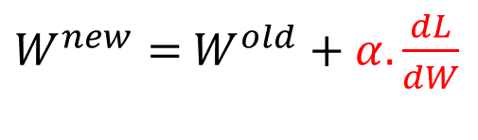

Gradient Descent: Recap
$$W^{old}$$
$$L$$
$$\frac{dL}{dW}$$
$$W^{new}$$
$W^{new}=$ $W^{old}+α.\frac{dL}{dW}$
$$α$$
$$\frac{dL}{dW}$$
Most crucial task is how to compute:
Answer: Backprop

Slide 8




Univariate Chain Rule
Recall: if f (x) and x(t) are univariate functions, then
$$f$$
$$x$$
$$t$$

Slide 9
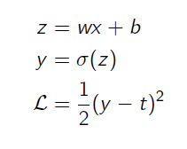
Univariate Chain Rule
Univariate logistic least squares model
Let’s compute derivates.

Slide 10
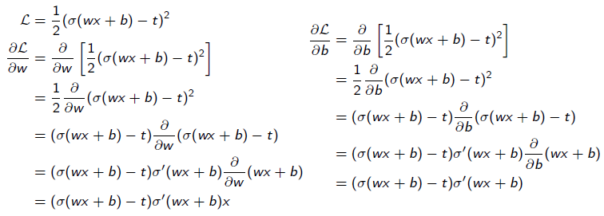
Univariate Chain Rule
How you would have done it in calculus class
What are the disadvantages of this approach?

Slide 11
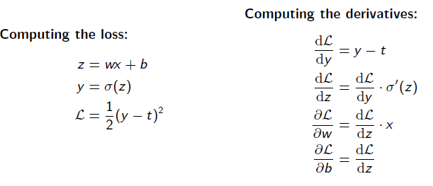
Univariate Chain Rule
A more structured way to do it

Slide 12
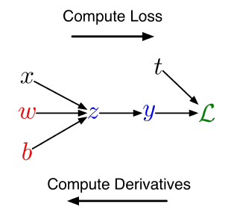
Univariate Chain Rule
We can diagram out the computations using a computation graph.
The nodes represent all the inputs and computed quantities, and the edges represent which nodes are computed directly as a function of which other nodes.

Slide 13
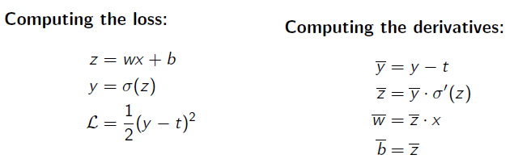
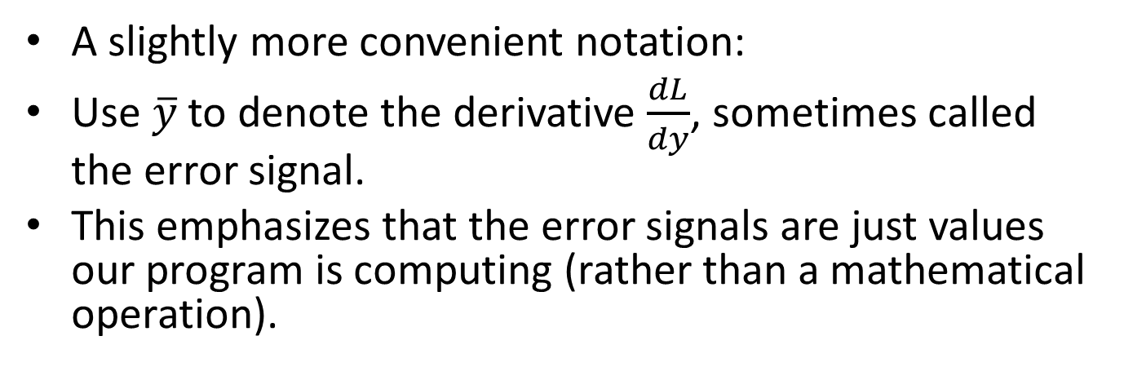
Univariate Chain Rule
A slightly more convenient notation:
Use $\overline{y}$ to denote the derivative $\frac{dL}{dy}$, sometimes called the error signal.
This emphasizes that the error signals are just values our program is computing (rather than a mathematical operation).

Slide 14
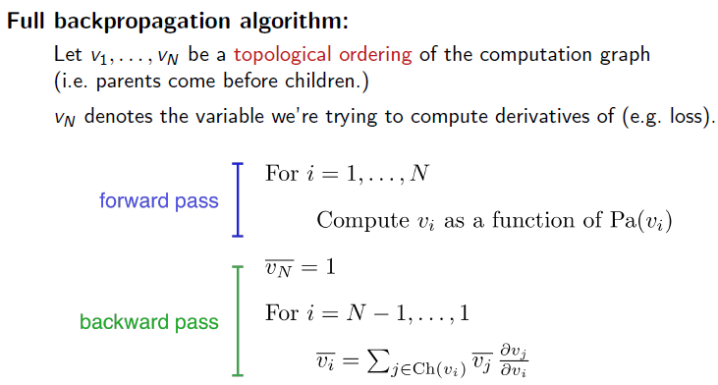
Backprop Algorithm

Slide 15
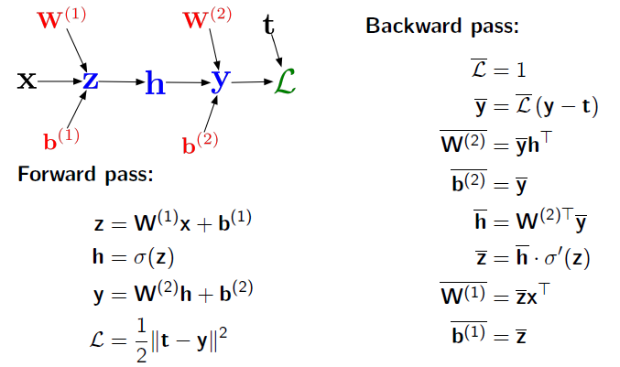
Backprop Algorithm: Vectorized Form

